Slide 1

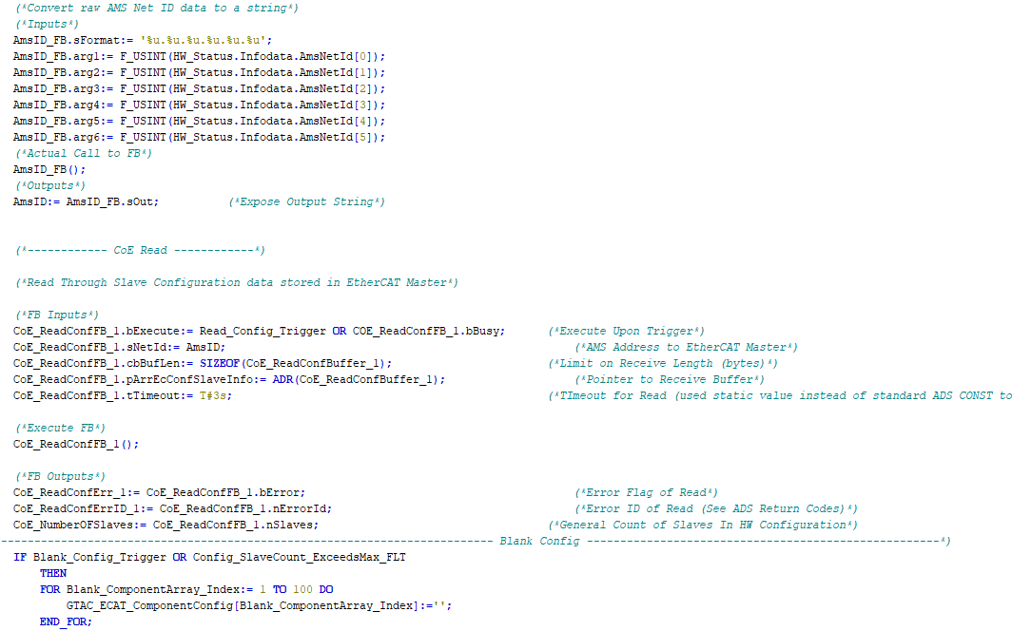

Controls Training
Part 1:
The Building Blocks -> POUs, PRGs, FBs, FUNs, UDTs

Slide 2
But first, some background:
IEC 61131
IEC 61131 is an IEC standard for programmable controllers.
First published in 1993, the current (third) edition was edited in 2013.
It was known as IEC 1131 before the change in numbering system by IEC.
It is a 10-part standard as follows
Part 1: General information.
Part 2: Equipment requirements and tests
Part 3: Programming languages
Part 4: User guidelines
Part 5: Communications
Part 6: Functional safety
Part 7: Fuzzy control programming
Part 8: Guidelines for the application and implementation of programming languages
Part 9: Single-drop digital communication interface for small sensors and actuators
Part 10: PLC open XML exchange format for the export and import of IEC 61131-3 projects

Slide 3
But first, some background:
IEC 61131-3
IEC 61131-3 is the third part (of 10) of the open international standard IEC 61131
for programmable logic controllers.
Part 3 of IEC 61131 deals with basic software architecture and programming languages of the control program within PLC. It defines three graphical and two textual programming language standards
Ladder diagram (LD): graphical
Function block diagram (FBD): graphical
Structured text (ST): textual
Instruction list (IL): textual (deprecated in 3rd revision of the standard)
Sequential function chart (SFC): graphical.
Find more detail here -> https://en.wikipedia.org/wiki/IEC_61131-3

Slide 4
Data Types
In computer science and programming, a data type or simply type is an attribute of data which tells the compiler or how the programmer intends to use the data.
The software architecture portion of IEC 61131-3
groups data types into three general categories
Elementary Data Types
Generic Data Types (TC3 only)
User-defined Data Types

Slide 5
Data Types
Elementary Data Types
BIT STRING GROUP
BOOL - 1 bit (0,1)
BYTE – 8 bit (1 byte)
WORD – 16 bit (2 byte)
DWORD – 32 bit (4 byte)
LWORD – 64 bit (8 byte)
INTEGER GROUP
SINT – signed short integer (1 byte)
INT – signed integer (2 byte)
DINT – signed double integer (4 byte)
LINT – signed long integer (8 byte)
USINT – Unsigned short integer (1 byte)
UINT – Unsigned integer (2 byte)
UDINT – Unsigned double integer (4 byte)
ULINT – Unsigned long integer (8 byte)
REAL / FLOATING POINT GROUP
REAL – (4 byte)
LREAL – (8 byte)
DURATION GROUP
TIME – (4 byte). Literals in the form of T#5m90s15ms
LTIME – (8 byte). Literals extend to nanoseconds in the form of T#5m90s15ms542us15ns
DATE GROUP
DATE – calendar date
LDATE – calendar date (Doesn’t seem avail in TC)
TIME OF DAY (TOD) GROUP
TIME_OF_DAY / TOD – clock time
LTIME_OF_DAY / LTOD – clock time (8 byte)
DATE AND TIME OF DAY GROUP
DATE_AND_TIME / DT – time and date
LDATE_AND_TIME / LDT – time and date(8 byte)
CHARACTERS AND STRINGS GROUP
CHAR – Single-byte character (1 byte)
WCHAR – Double-byte character (2 byte)
STRING – Variable-length single-byte character string.
WSTRING – Variable-length double-byte character string.

Slide 6
Data Types
In computer science and programming, a data type or simply type is an attribute of data which tells the compiler or how the programmer intends to use the data.
The software architecture portion of IEC 61131-3
groups data types into three general categories
Elementary Data Types
Generic Data Types
User-defined Data Types

Slide 7
Data Types
User-defined Data Types
UDTs (DUTs)
Enumerated data type
Enumerated data type with named value
Subrange data type – puts limits on value i.e., INT(4 .. 20) for current
Array data type – multiple values stored in the same variable
Structured data type – composite of several variables and types
Directly derived data type – type derived from one of the above types to give new name and initial value as a type
References – a kind of strongly typed pointer. Arithmetic operation of the value of this type is prohibited

Slide 8
UDTs (DUTs)
User-defined Data Types
Let’s develop a UDT

Slide 9
POUs
Program Organization Units
The software architecture portion of IEC 61131-3
groups POUs into three general categories
Programs (PRGs)
Functions (FUNs)
Standard: ADD, SQRT, SIN, COS, GT, MIN, MAX, AND, OR, etc. for example
Custom: Created by application developer
Function Blocks (FBs)
Standard: Libraries of functions can be supplied by a vendor or third party as example
Custom: Created by application developer

Slide 10
POUs
Program Organization Units
PRGs, FUNs, FBs
Let’s develop some POUs

Slide 11

Anything not make sense?
Where are we going with this?
Questions

Slide 12

Thanks for your time

